Slide 1

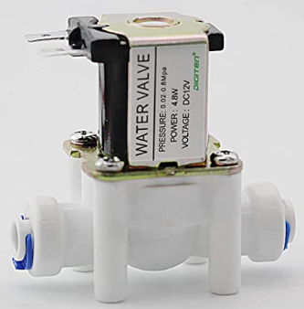
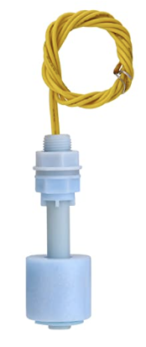
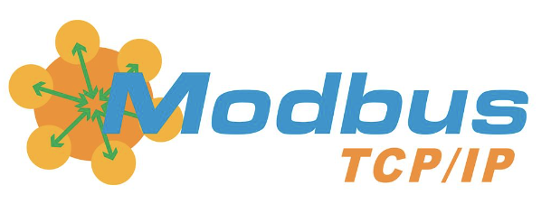
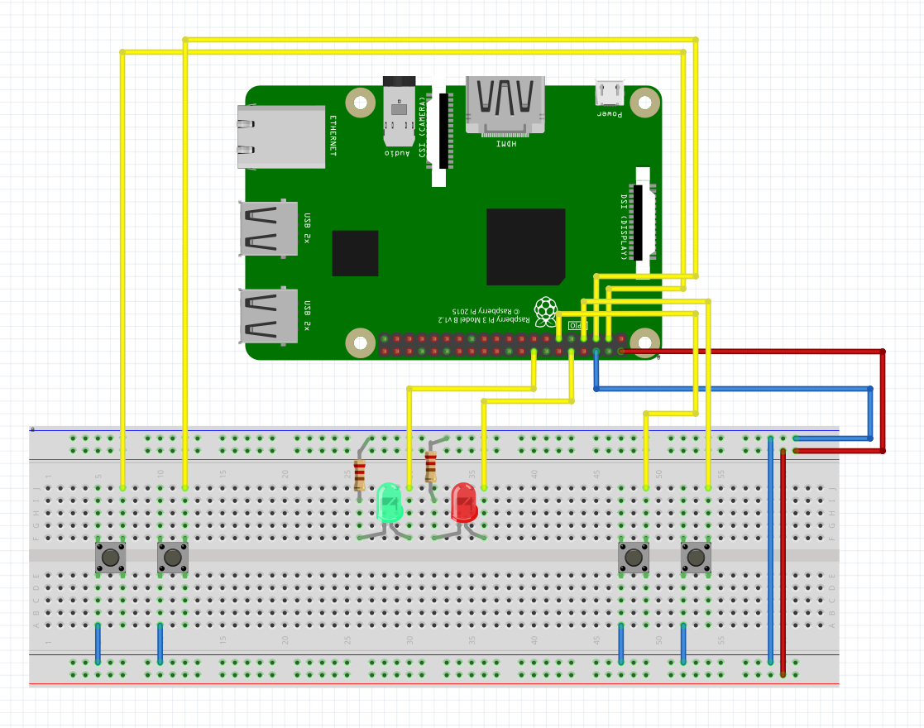
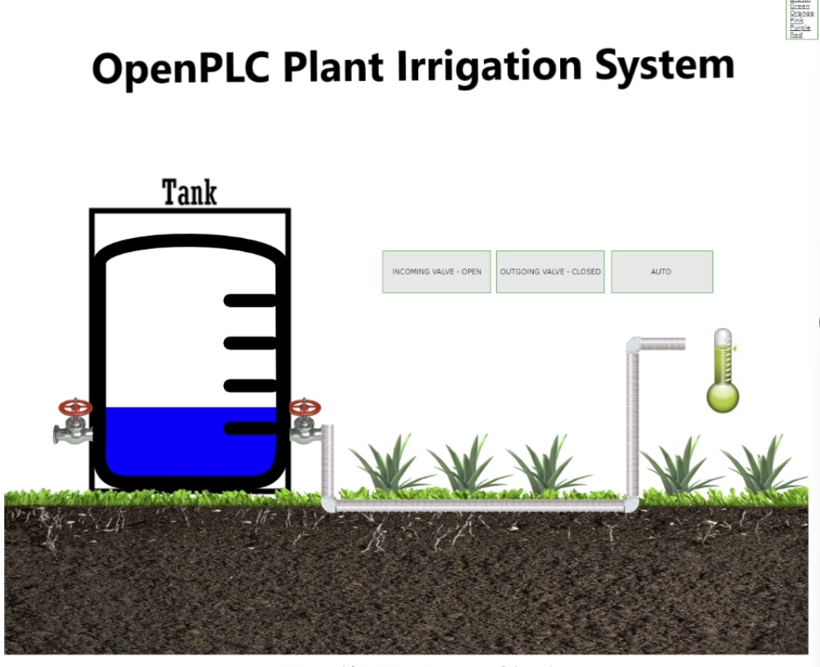

Implementation and Hacking of a Plant Irrigation System
Charlie Hernandez, Zachary Drake • Dr. Scott Feister • Comp 499
Introduction
Equipment Used
Literature Cited (or type a new title here)
In the world of automation, Programmable Logic Controllers (PLCs) are ruggedized industrial computers that have been at the forefront of manufacturing processes since the late 60’s. Due to their ability to run mission-critical applications for years and even decades, PLCs are often seen as trusted computers within manufacturing plants. With the rollout of the internet in the 90’s, PLCs were introduced to a mirage of cybersecurity vulnerabilities due to the extremely low security of the Modbus TCP/IP protocol, the de facto protocol that PLCs use to communicate.
The purpose of this project is to demonstrate just how vulnerable these mission-critical computers are by implementing a plant irrigation system using PLC software within a network. A command injection attack will be executed against our PLC network to exploit the vulnerabilities of the Modbus protocol.
Raspberry Pi
Push buttons (4)
LEDs (2)
4-relay board
Water float sensors (2)
Water containers (2)
3D printed farm
12v adapter (2)
Solenoid water valves (2)
Enter cited Literature here…
Methodology
Acknowledgements (or type a new title here)
OpenPLC, and open-source PLC software that can be used with microcontrollers and Raspberry Pi’s, will be our main platform to emulate a PLC with our Raspberry Pi. This platform will turn our Pi into a fully-fledged PLC that can run Ladder Diagrams / Structured Text programs and communicate using the Modbus TCP/IP protocol.
The goal of the irrigation system is simple: Water the plants to keep them alive. If the moisture sensor detects the plants are dry, turn on the pump to water the plants. If the program detects the tank is empty, the inlet valve will turn on and rush water into the tank from a water source.
Our project will have two methodologies:
Software Simulation – The irrigation system will be simulated using SCADABr, an open-source SCADA (supervisory control and data acquisition) webapp. SCADA is a protocol used by industrial control systems engineers to monitor and control industrial processes in real time, usually from remote locations.
Hardware Simulation – The irrigation system will be simulated using real hardware. The hardware simulation will be slightly different compared to the software simulation, but with the same purpose.
Enter acknowledgements here…
Conclusions (or type a new title here)
Enter your conclusion text here…
Further Reading (or type a new title here)
Enter related texts/literature here…

